Slide 2
Why OttLite?
Range Proposal

Slide 3
The Opportunity for your customer base
OttLite, already well known in the US lighting are investing heavily in Europe
The products are without exception innovative, high quality and with many unique features
The range is well positioned for your existing customer base alongside existing ranged product, giving you a great opportunity to drive incremental business

Slide 4
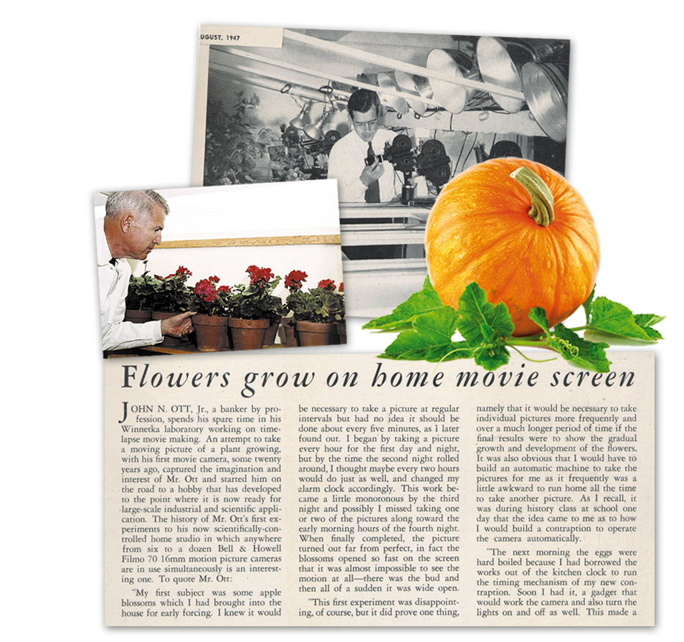
The Company Expertise and Heritage
Dr. John Nash Ott was asked by the Walt Disney Company to film the growth of a pumpkin for Disney animators.
After several experiments, Dr. Ott was able to provide the proper range of light wavelengths and the pumpkin grew.
This work sparked his imagination leading him to explore the benefits of natural daylight and how it can help people see and feel better.
Dr. Ott’s research provided the foundation for OttLite Technologies to bring the power of natural daylight indoors!

Slide 5
The Product Features and Benefits
See fine print clearly and colours accurately
Strict compliant standards
Innovative features
Super bright LEDs
Long lasting and energy efficient
Multiple price points, styles and promotion opportunities
Tailored product bespoke features, colours, models, branding and packaging available.

Slide 6
Proprietary Natural Daylight LEDs
Working with chemists and product engineers, OttLte have developed a proprietary phosphor, diode and diffuser combination that emits a naturally balanced spectrum similar to natural daylight – the optimal condition for seeing everything clearly and comfortably.
Reduced glare and eyestrain
Clear, natural daylight illumination
High contrast for fine details and print
Excellent color rendering (CRI of 90+)
Even, balanced light disbursement

Slide 7
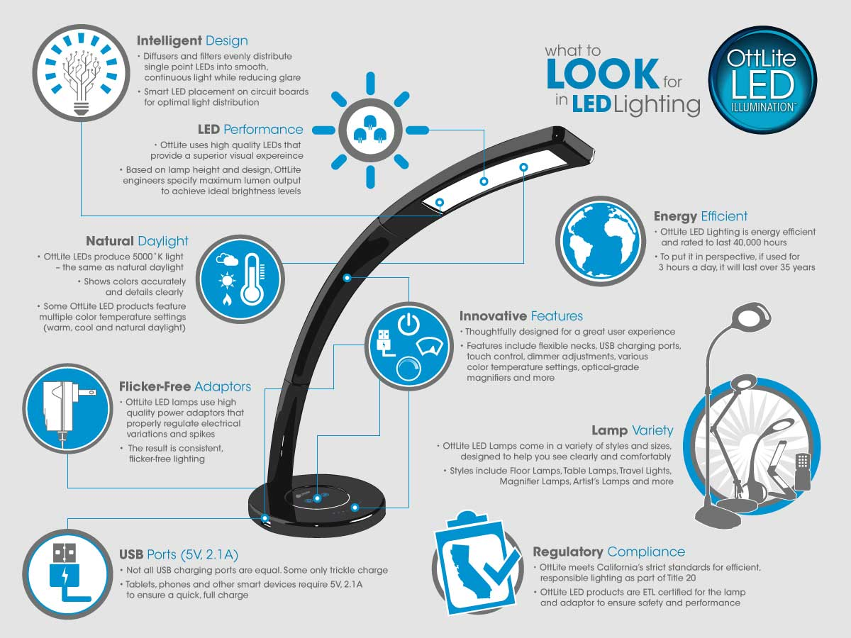

Slide 8
Range Proposal

Slide 9
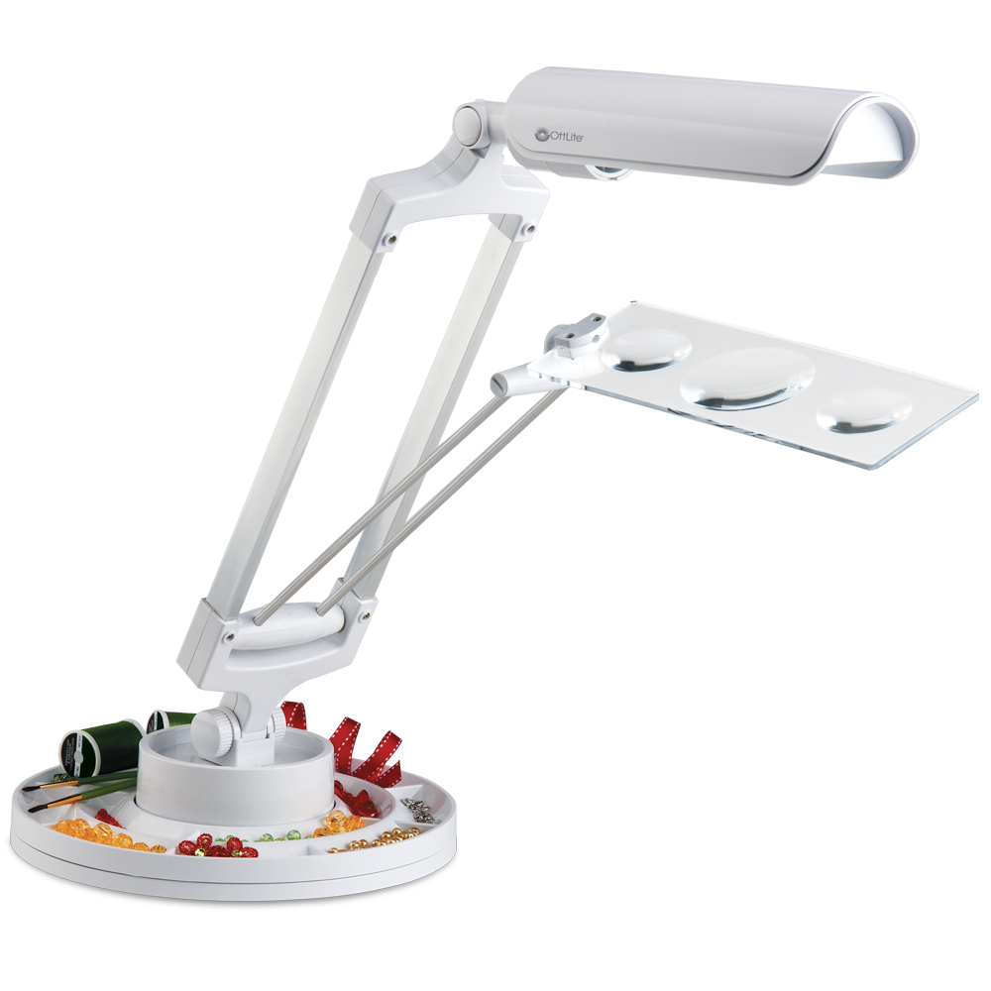
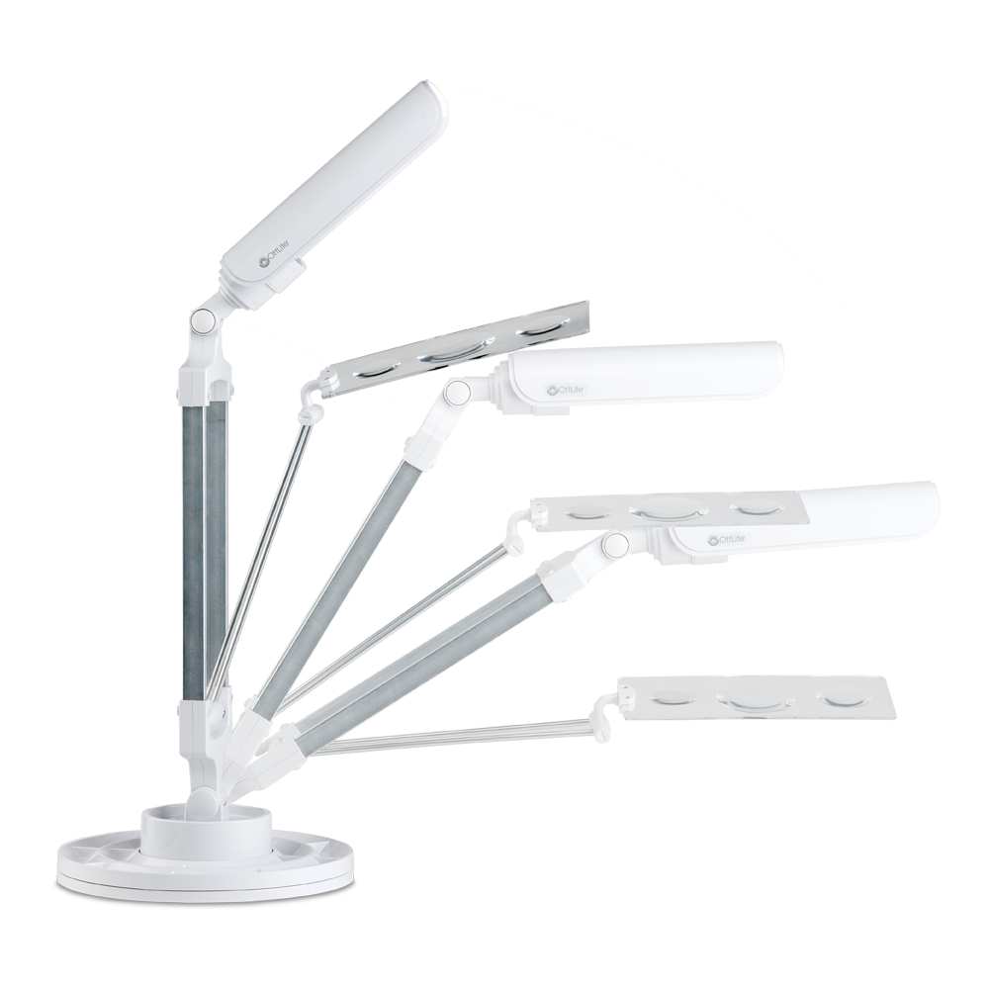
13W Spin & Store Desk Lamp
The 13w Craft Organizer lamp is great for bringing OttLite Illumination™ to both large and small projects. The low heat, low glare illumination dramatically helps reduce eyestrain for hours of creative fun. Plus, the lamp features a removable organizer tray that rotates a full 360 degrees, so it’s perfect for sorting beads, embellishments, threads and more.
Storage tray spins for easy access to crafty accessories
2x and 3x spot magnifiers (9.5" length x 3.5" width)
Multi-position shade adjusts light easily

Slide 10
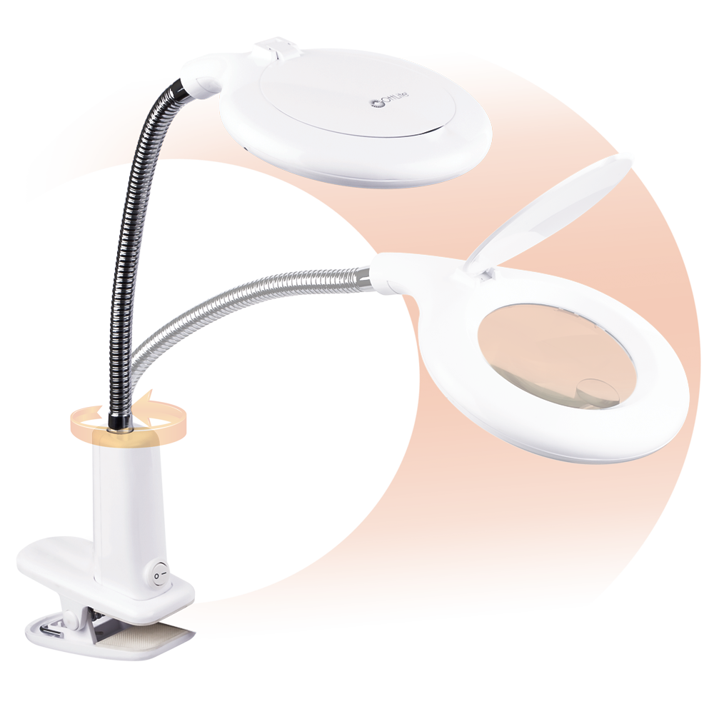
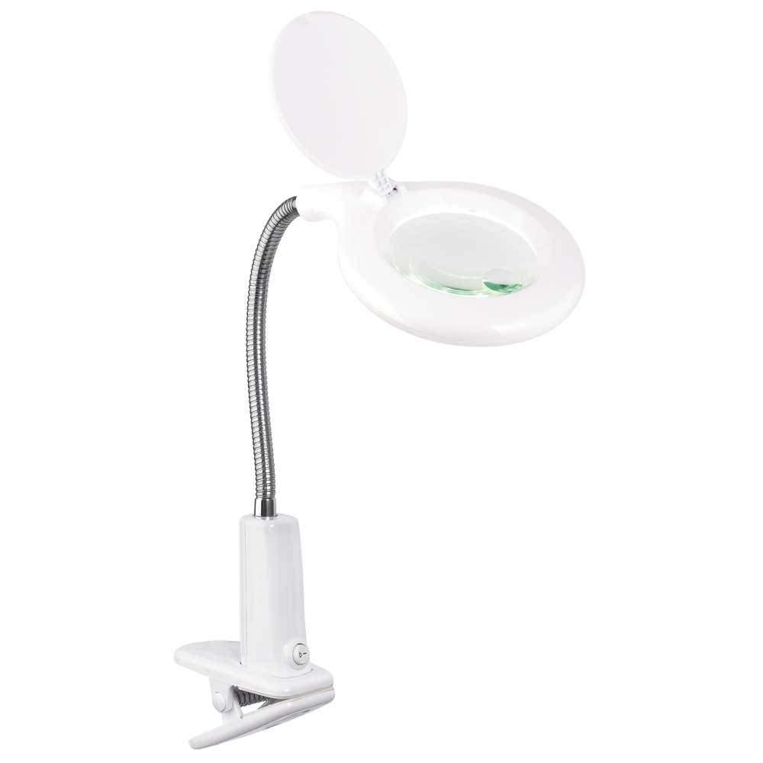
LED Clip-On Magnifier
The LED Clip-On Magnifier is a magnifying lamp and then some! Optical-grade magnification with 360 degree OttLite LED Illumination helps you see all the details clearly whether you’re working, reading illuminated magnification right where you need it while or crafting.
The flexible neck directs the sturdy clip attaches to desks, workbenches and more. Featuring a 1.75x magnifier lens with a 4x spot magnifier, the flip shade closes to protect the magnifier when not in use. With OttLite you can see details clearly so you can do what you love, longer.

Slide 11
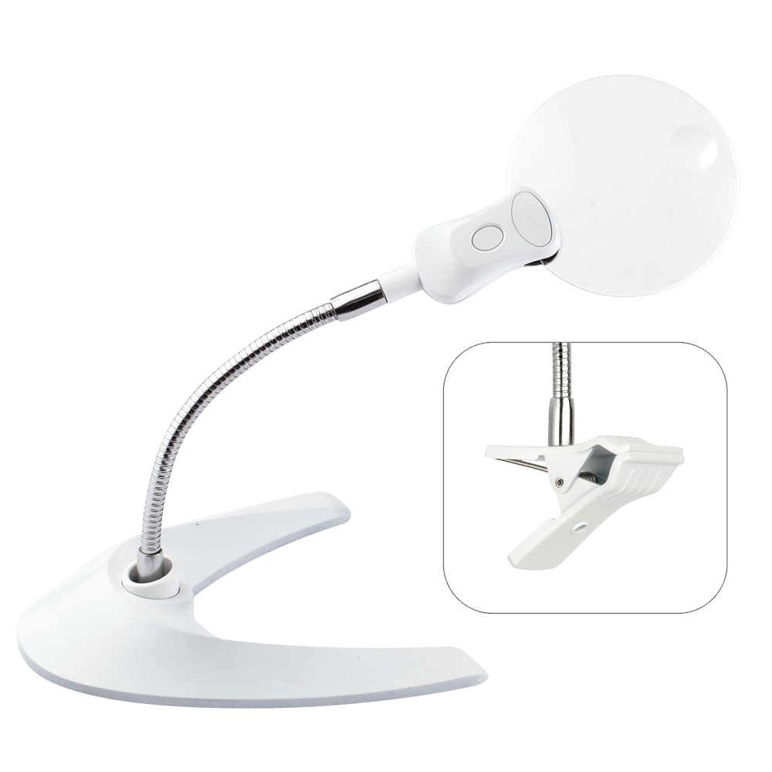
LED Magnifier with Clip and Stand
View fine details clearly and easily with the 3.5-Inch LED Magnifier Light with Clip and Stand. Easily position the illuminated optical-grade magnifier using the flexible arm to make seeing intricate projects virtually effortless. The sturdy clip attaches to most work surfaces, or switch to the weighted stand for table-top use.

Slide 12
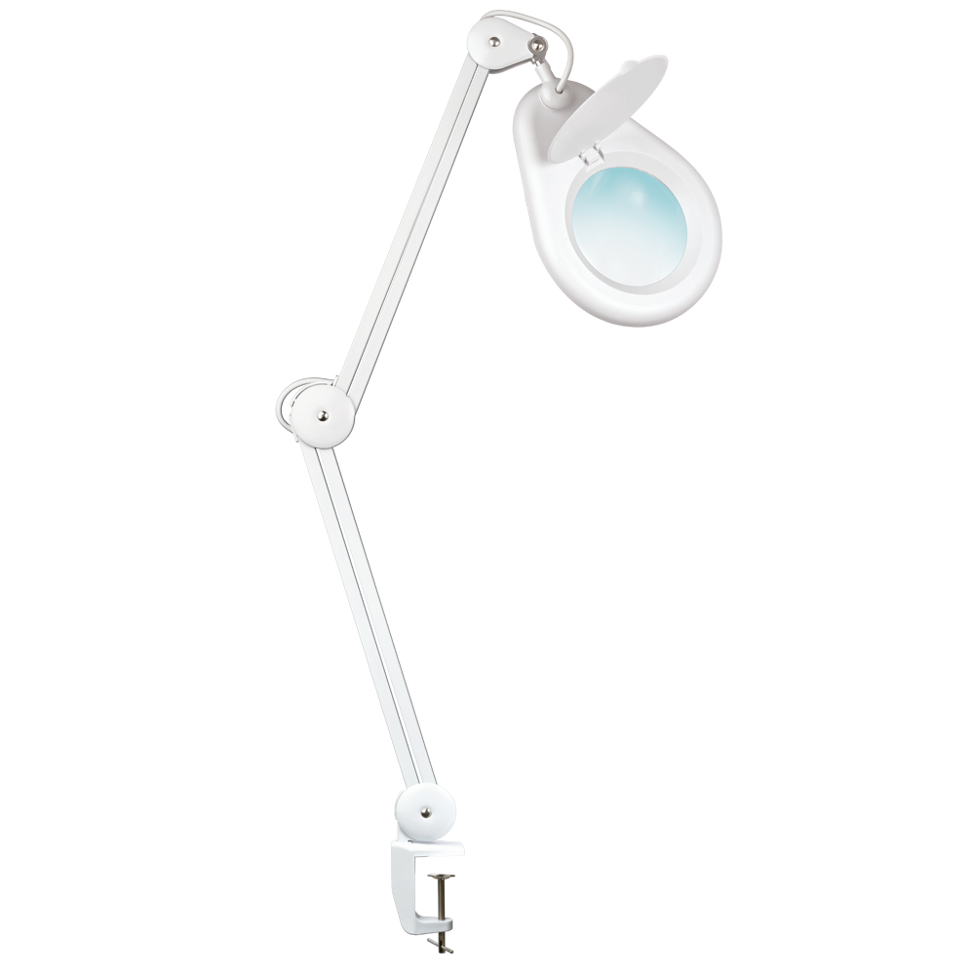
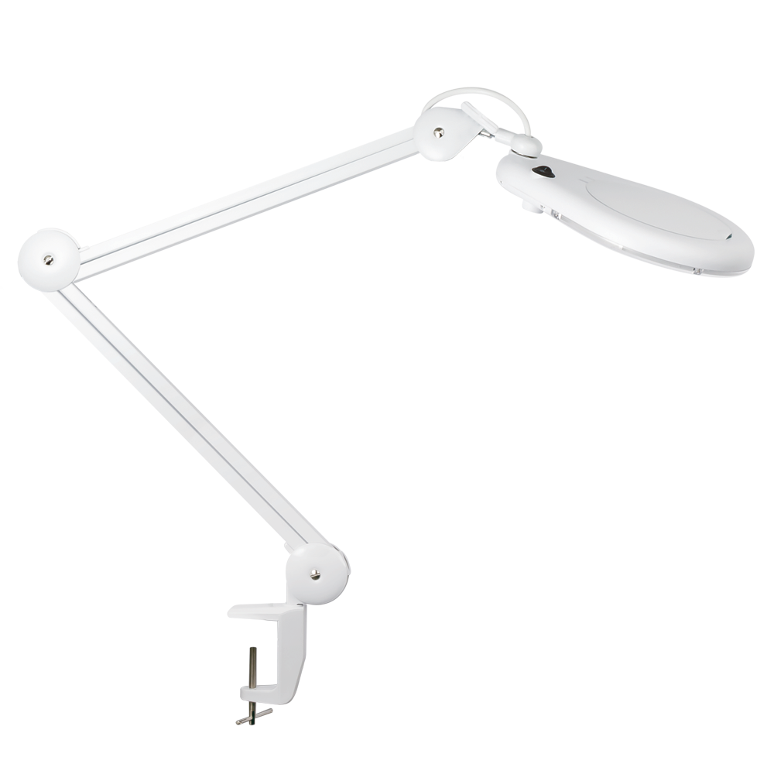
22W Clamp Magnifier
The ultimate tool for the serious crafter. The 22w Clamp Magnifier brings the best in OttLite illumination combined with an optical-grade magnifier. The sturdy and versatile clamp attaches to desks, workbenches, tables, and much more. Features an articulating arm and rotating head with 360 degree illumination for precise viewing and angle placement. Flip shade closes to protect the magnifier when not in use. The perfect magnifying lamp for beading, fly fishing, hand sewing and many other hobbies!

Slide 13
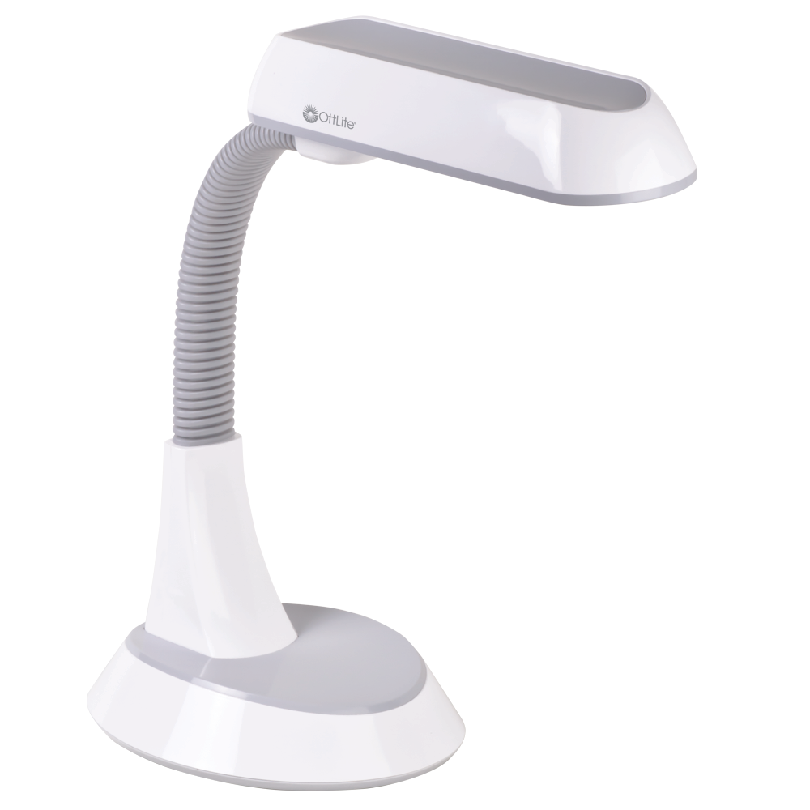
18w Table Lamp
Adapted from the best-selling Floor Lamp, the 18w Table Lamp offers powerful illumination and total flexibility. Ideal for tables, countertops and work benches. Shade height and angle can be easily adjusted with one hand using the flexible neck. By delivering the right mix of brightness and contrast, OttLite Illumination lets you see colours, fine print and details with ease under this unique low heat, low glare illumination that helps reduce eyestrain

Slide 14
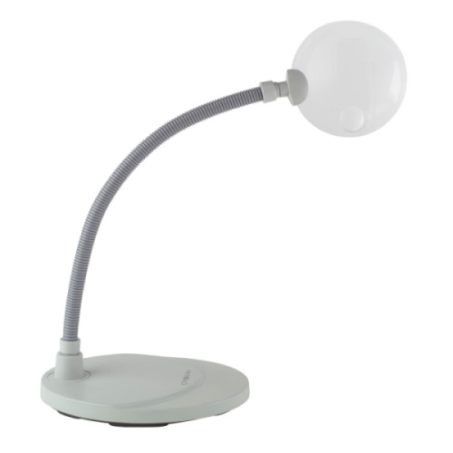
Freestanding Magnifier
The OttLite 5x Freestanding Magnifier delivers crystal clear optical-grade magnification, so you’ll see intricate details more easily. Featuring a stylish rimless lens with a spot magnifier, the flexible yet sturdy arm makes this the perfect accessory to complement your OttLite lamp.

